Slide 1


TensorFlow @UST
Day 3: RNN
Sung Kim <hunkim+tfust@gmail.com>

Slide 2
TensorFlow @UST
Day 3: RNN
Sung Kim <hunkim+tfust@gmail.com>

Slide 3



Gifts from Google and Line

Slide 4

Feedback

Slide 5

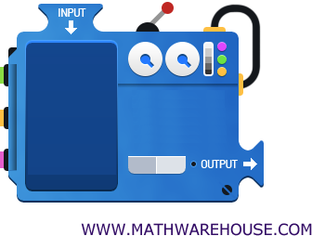
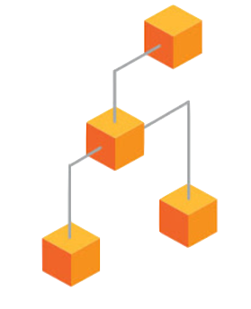



TensorFlow Mechanics
feed data and run graph (operation) sess.run (op, feed_dict={x: x_data})
Build graph using
TensorFlow operations
update variables
in the graph
(and return values)

Slide 6
Machine Learning Basics
Linear Regression
Logistic Regression (Binary classification)
Softmax Classification
Neural Networks
CNN

Slide 7
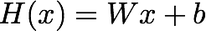
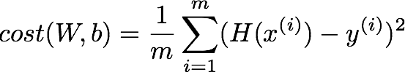
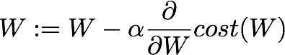
Linear Regression
W = tf.Variable(tf.random_normal([1]), name='weight')
b = tf.Variable(tf.random_normal([1]), name='bias')
# Our hypothesis XW+b
hypothesis = X * W + b
# cost/loss function
cost = tf.reduce_mean(tf.square(hypothesis - y_train))
GradientDescent
# Minimize
train = tf.train.GradientDescentOptimizer(learning_rate=0.01).minimize(cost)

Slide 8
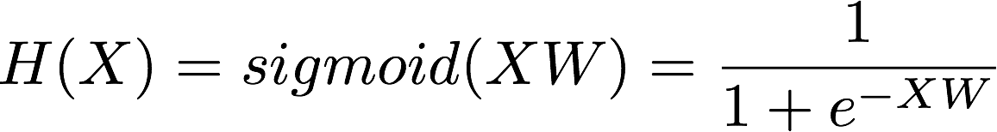
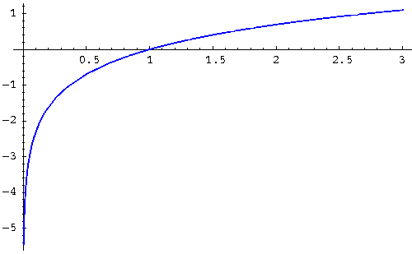
Logistic Regression
Model? (Hypothesis?)
hypothesis = tf.sigmoid(tf.matmul(X, W) + b)
Cost?
# cost/loss function
cost = -tf.reduce_mean(Y * tf.log(hypothesis) + (1 - Y) *
tf.log(1 - hypothesis))
GradientDescent
train = tf.train.GradientDescentOptimizer(learning_rate=0.01).minimize(cost)

Slide 9
Softmax Classifier
Model? (Hypothesis?)
logits = tf.matmul(X,W)+b
hypothesis = tf.nn.softmax(logits)
Cost?
# Cross entropy cost/loss
cost = tf.reduce_mean (-tf.reduce_sum(Y * tf.log(hypothesis), axis=1))
GradientDescent
train = tf.train.GradientDescentOptimizer(learning_rate=0.01).minimize(cost)

Slide 10
Softmax Classifier
Model? (Hypothesis?)
logits = tf.matmul(X,W)+b
hypothesis = tf.nn.softmax(logits)
Cost?
# Cross entropy cost/loss
cost = tf.reduce_mean (-tf.reduce_sum(Y * tf.log(hypothesis), axis=1))
cost = tf.reduce_mean(
tf.nn.softmax_cross_entropy_with_logits(logits=logits, labels=Y))
GradientDescent
train = tf.train.GradientDescentOptimizer(learning_rate=0.01).minimize(cost)

Slide 11
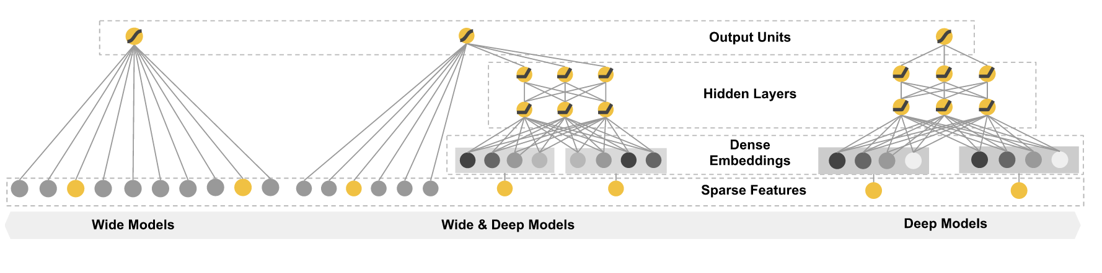
(Deep) Neural Nets
NN for MNIST
# input placeholders
X = tf.placeholder(tf.float32, [None, 784])
Y = tf.placeholder(tf.float32, [None, 10])
# weights & bias for nn layers
W1 = tf.Variable(tf.random_normal([784, 256]))
b1 = tf.Variable(tf.random_normal([256]))
L1 = tf.nn.relu(tf.matmul(X, W1) + b1)
W2 = tf.Variable(tf.random_normal([256, 256]))
b2 = tf.Variable(tf.random_normal([256]))
L2 = tf.nn.relu(tf.matmul(L1, W2) + b2)
W3 = tf.Variable(tf.random_normal([256, 10]))
b3 = tf.Variable(tf.random_normal([10]))
hypothesis = tf.matmul(L2, W3) + b3
# define cost/loss & optimizer
cost = tf.reduce_mean(tf.nn.softmax_cross_entropy_with_logits(
logits=hypothesis, labels=Y))
optimizer = tf.train.AdamOptimizer(learning_rate=learning_rate).minimize(cost)

Slide 12
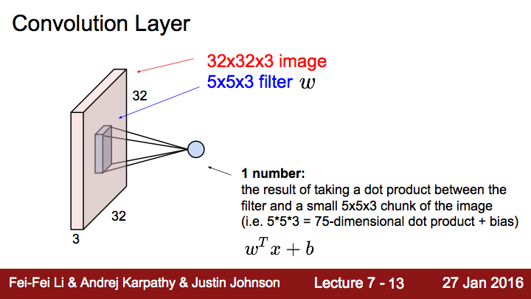

Slide 13
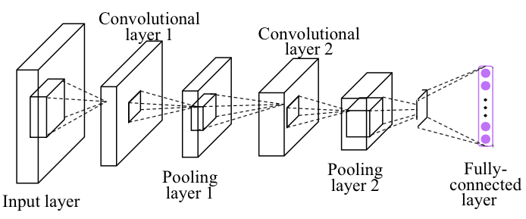
Simple CNN
# img 28x28x1 (black/white), Input Layer
X_img = tf.reshape(self.X, [-1, 28, 28, 1])
self.Y = tf.placeholder(tf.float32, [None, 10])
# Convolutional Layer and pooling layer #1
conv1 = tf.layers.conv2d(inputs=X_img, filters=32, kernel_size=[3, 3], padding="SAME", activation=tf.nn.relu)
pool1 = tf.layers.max_pooling2d(inputs=conv1, pool_size=[2, 2], padding="SAME", strides=2)
dropout1 = tf.layers.dropout(inputs=pool1, rate=0.7, training=self.training)
# Convolutional Layer and Pooling Layer #2
conv2 = tf.layers.conv2d(inputs=dropout1, filters=64, kernel_size=[3, 3], padding="SAME", activation=tf.nn.relu)
pool2 = tf.layers.max_pooling2d(inputs=conv2, pool_size=[2, 2], padding="SAME", strides=2)
dropout2 = tf.layers.dropout(inputs=pool2, rate=0.7, training=self.training)
# Dense Layer with Relu
flat = tf.reshape(dropout3, [-1, 64 * 7 * 7])
dense4 = tf.layers.dense(inputs=flat, units=625, activation=tf.nn.relu)
dropout4 = tf.layers.dropout(inputs=dense4, rate=0.5, training=self.training)
# Logits (no activation) Layer: L5 Final FC 625 inputs -> 10 outputs
self.logits = tf.layers.dense(inputs=dropout4, units=10)
# define cost/loss & optimizer
self.cost = tf.reduce_mean(tf.nn.softmax_cross_entropy_with_logits(logits=self.logits, labels=self.Y))
self.optimizer = tf.train.AdamOptimizer(learning_rate=learning_rate).minimize(self.cost)

Slide 14
NN tips
Initilizing weights
Activation functions
Regularization
Optimizers

Slide 15
TensorFlow @UST
Day 3: RNN
Sung Kim <hunkim+tfust@gmail.com>

Slide 16
Sequence data
Hard to understand the context from single word
We understand based on the previous words + this word. (time series)
NN/CNN cannot do this

Slide 17
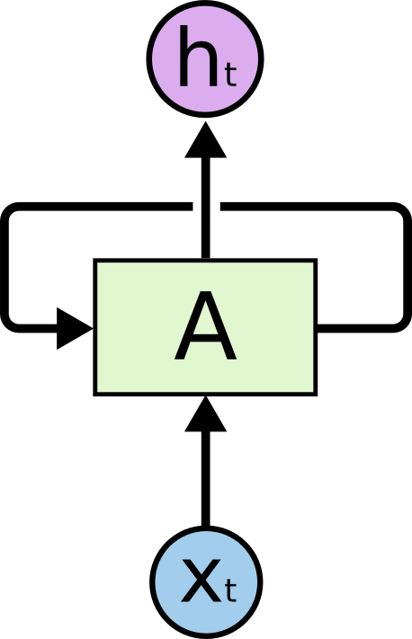
Sequence data
Hard to understand the context from single word
We understand based on the previous words + this word. (time series)
NN/CNN cannot do this
http://colah.github.io/posts/2015-08-Understanding-LSTMs/

Slide 18

http://colah.github.io/posts/2015-08-Understanding-LSTMs/

Slide 19
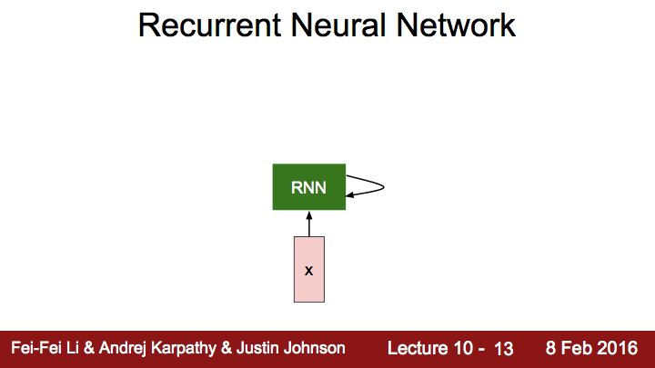

Slide 20
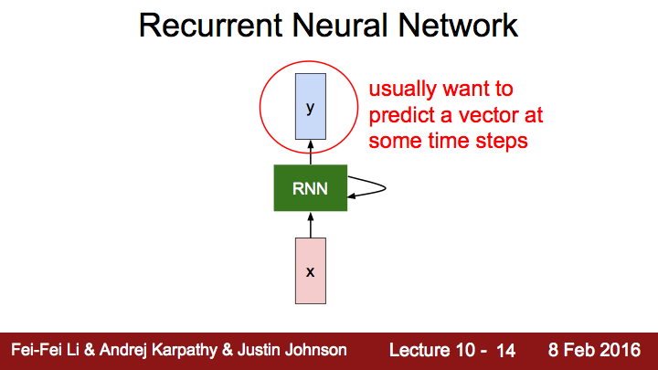

Slide 21
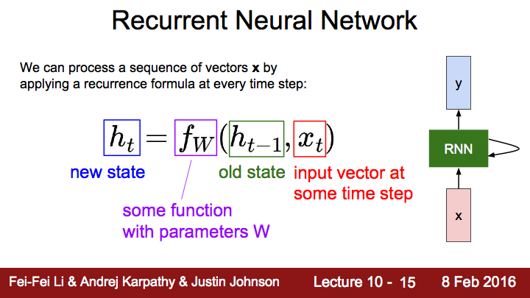

Slide 22
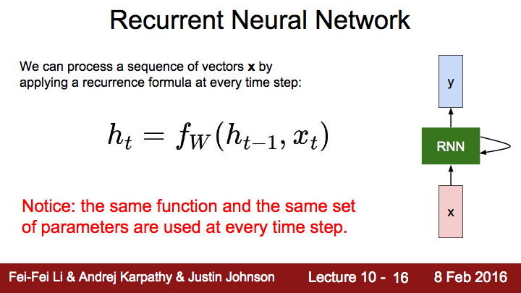

Slide 23
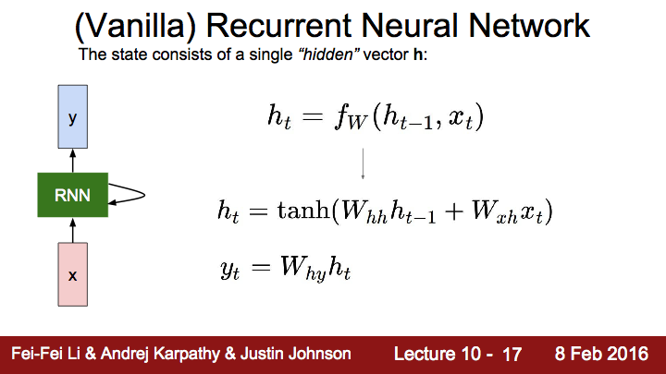

Slide 24
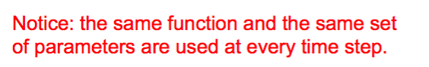
http://colah.github.io/posts/2015-08-Understanding-LSTMs/

Slide 25

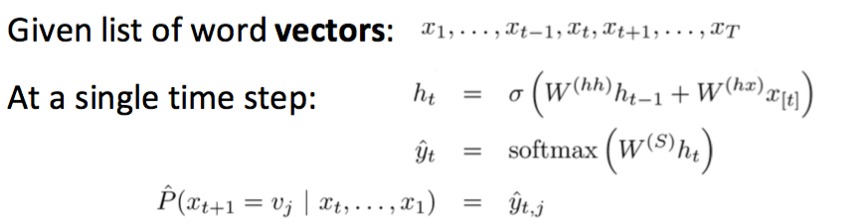
Notes:
Main idea: we use the same set of W weights at all time steps!

Slide 26
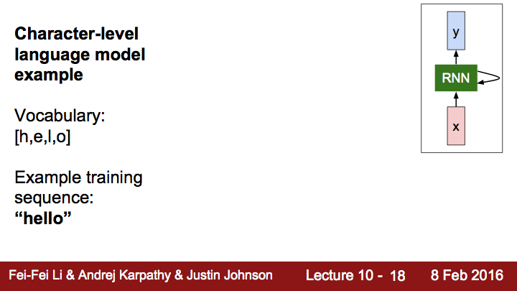
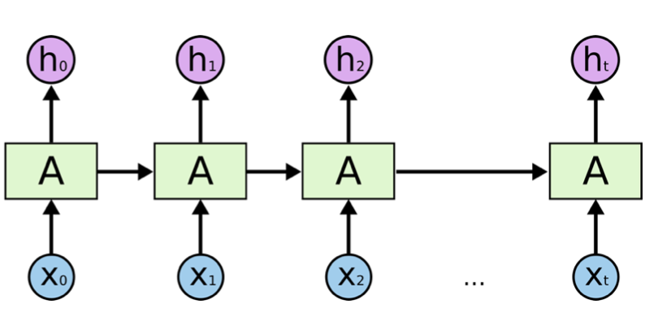

Slide 27
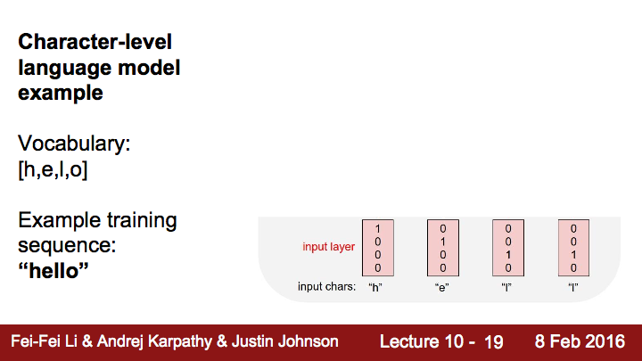

Slide 28
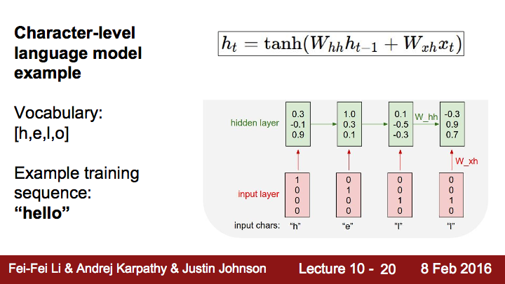

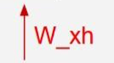

Slide 29
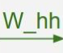

Slide 32
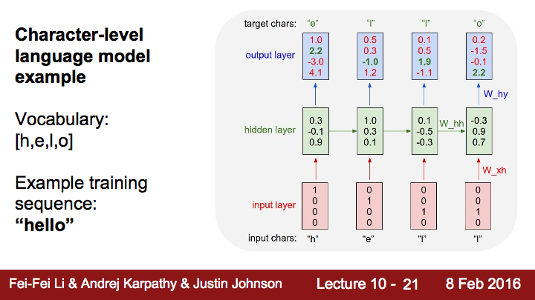
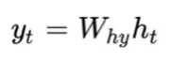
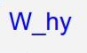


Slide 34
RNN applications
https://github.com/TensorFlowKR/awesome_tensorflow_implementations
Language Modeling
Speech Recognition
Machine Translation
Conversation Modeling/Question Answering
Image/Video Captioning
Image/Music/Dance Generation
https://kjw0612.github.io/awesome-rnn/

Slide 35
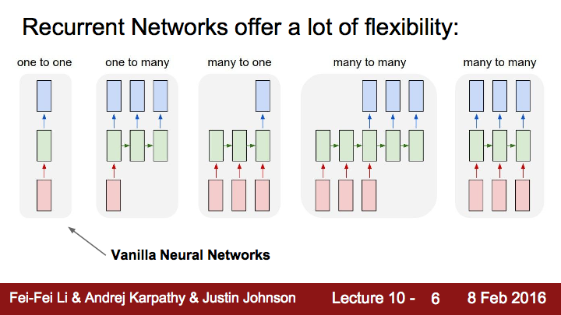

Slide 36
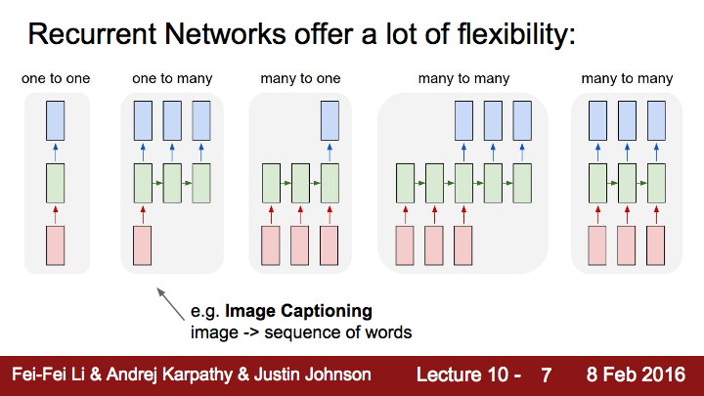

Slide 37
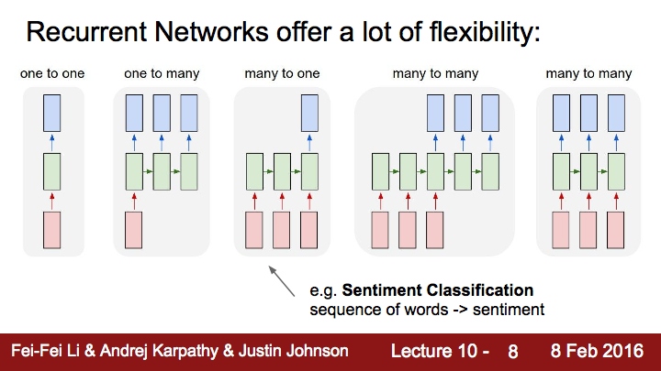

Slide 38
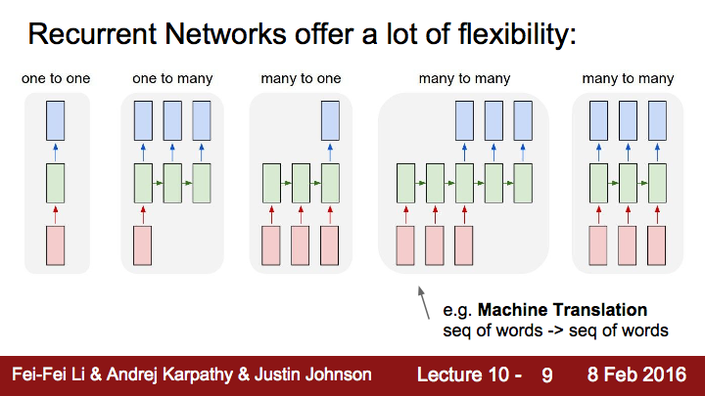

Slide 39
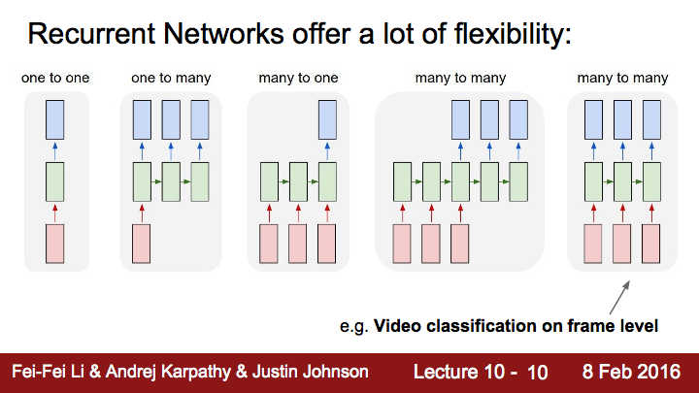

Slide 40
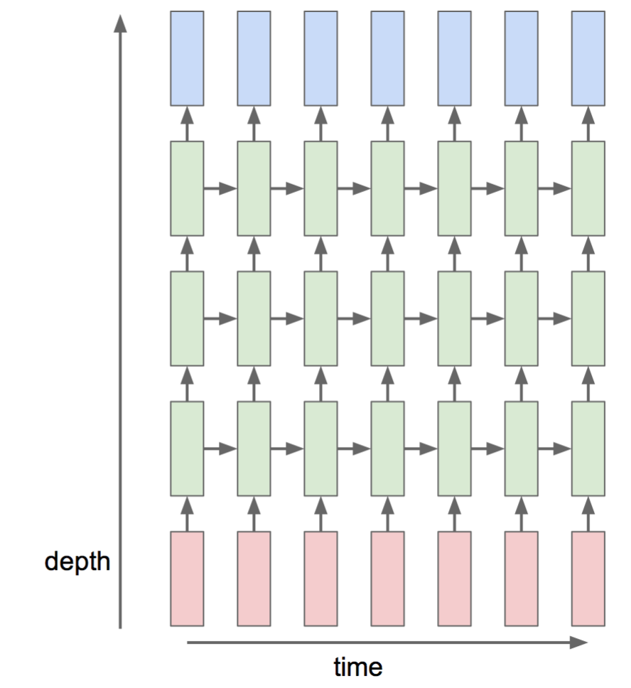
Multi-Layer RNN

Slide 41
Training RNNs is challenging
Several advanced models
Long Short Term Memory (LSTM)
GRU by Cho et al. 2014

Slide 42
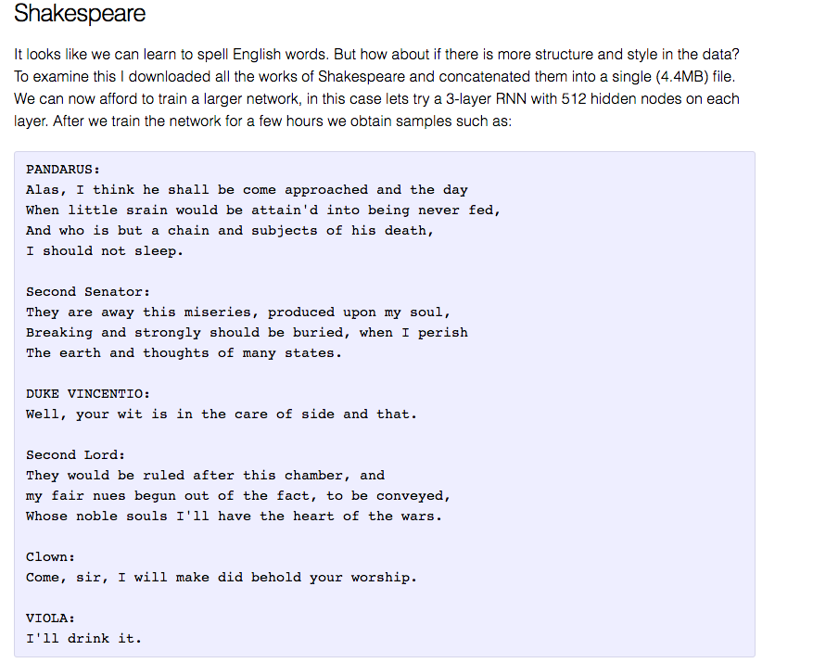
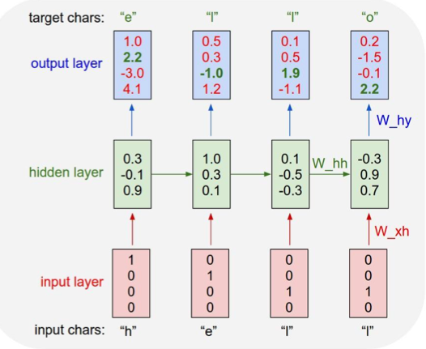
char-rnn

Slide 43
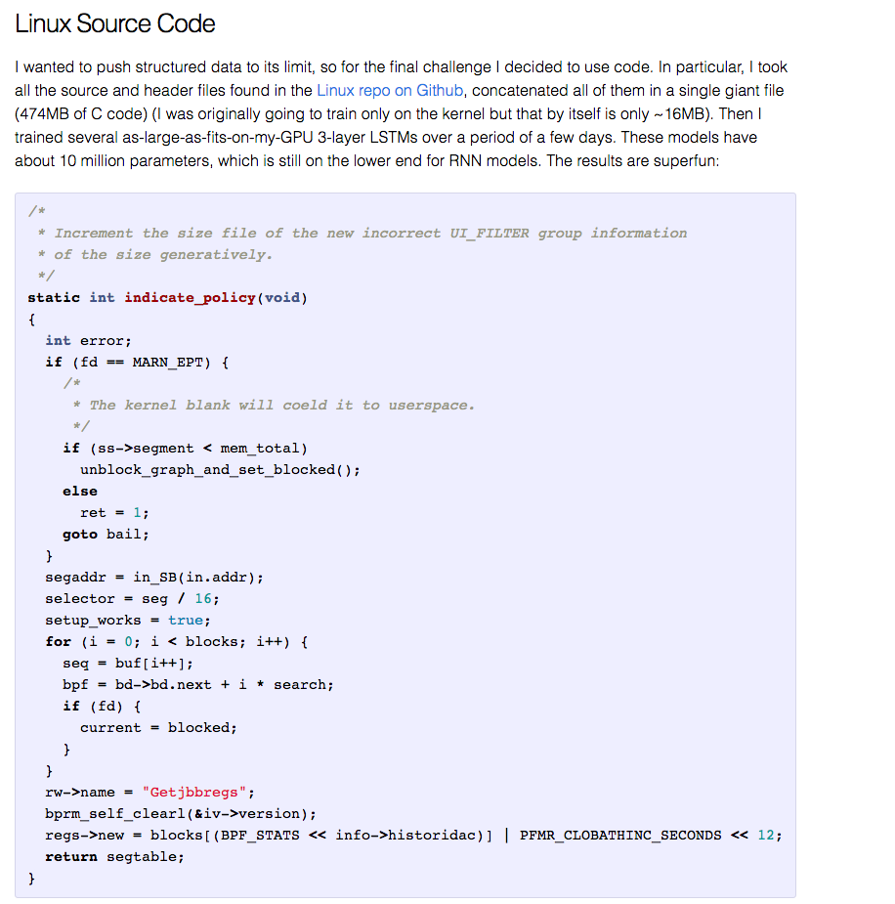

Slide 44
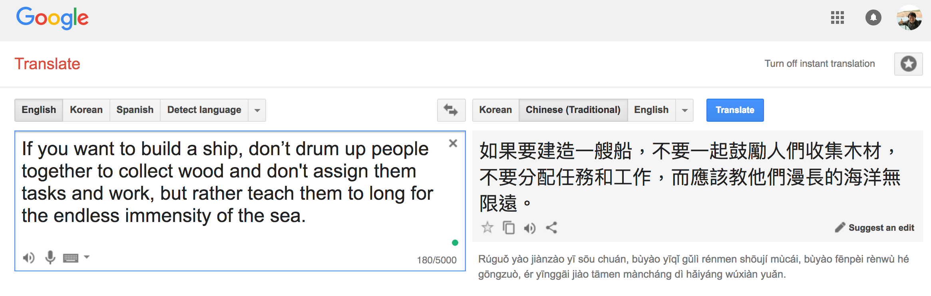
Google Translate
Notes:
For live demo with the different language:
"If you want to build a ship, don't drum up people together to collect wood and don't assign them tasks and work, but rather teach them to long for the endless immensity of the sea."

Slide 45
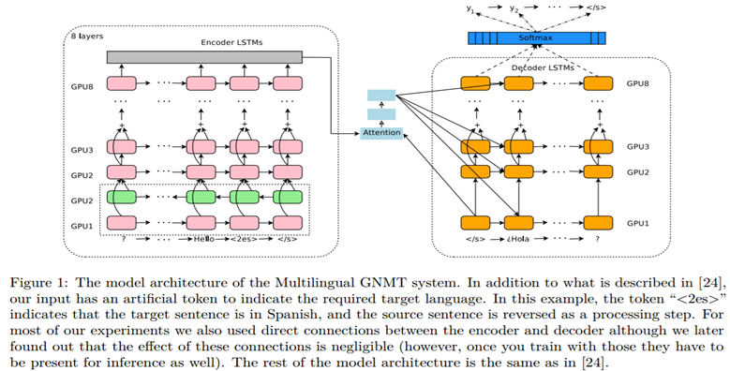
Multilingual Machine Translation with RNN

Slide 46
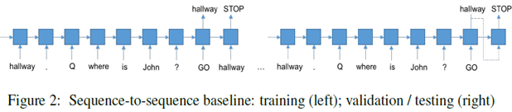
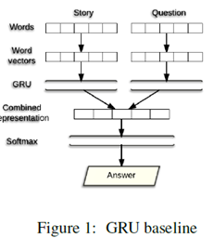
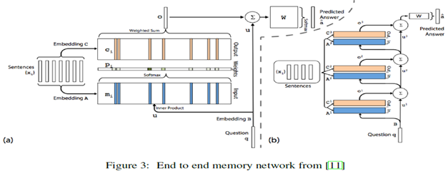
Question Answering with RNN
Notes:
QA and chat bots

Slide 47
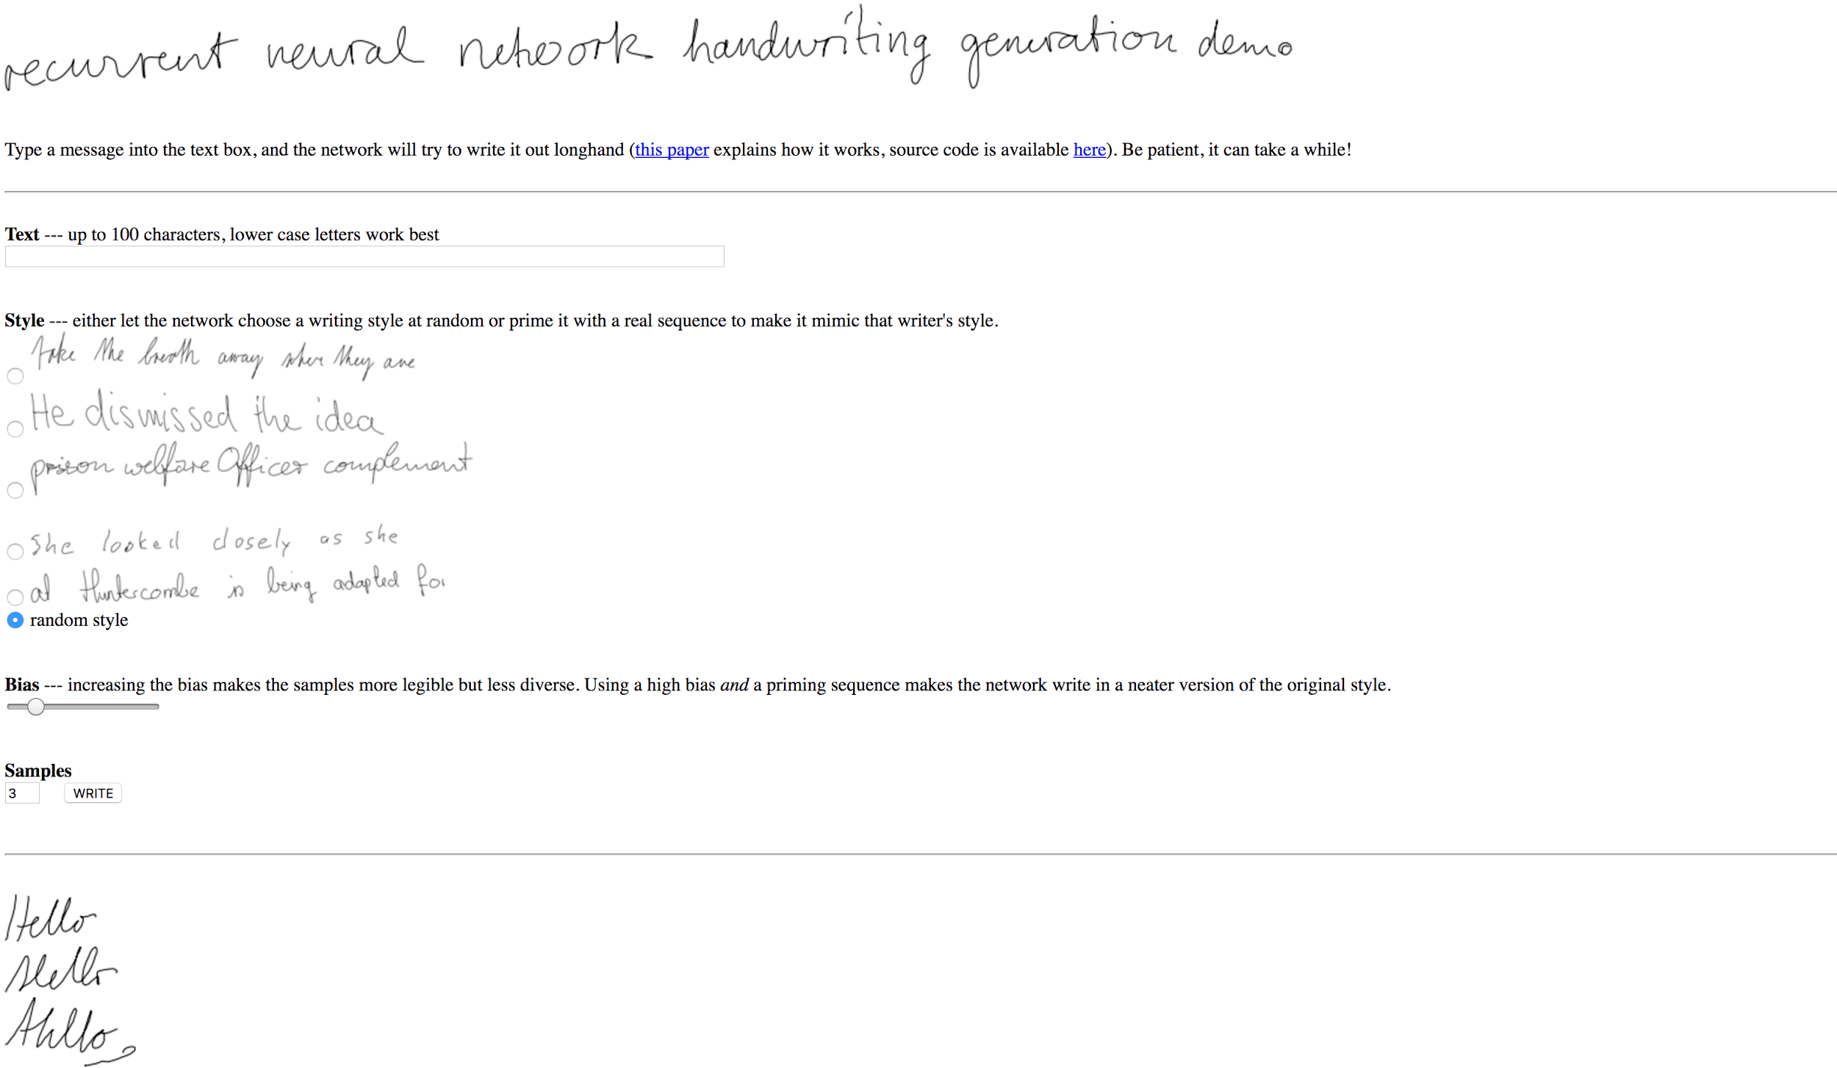
Handwriting generation
https://www.cs.toronto.edu/~graves/handwriting.html

Slide 48
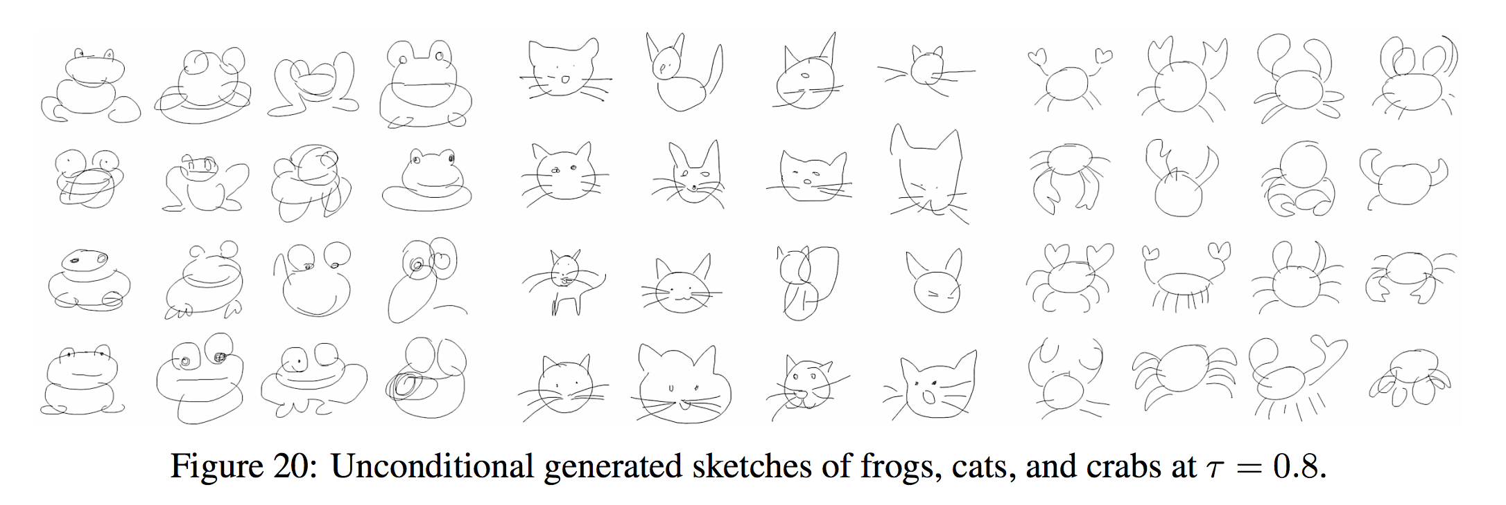
Sketch-RNN
https://arxiv.org/pdf/1704.03477v1.pdf

Slide 49
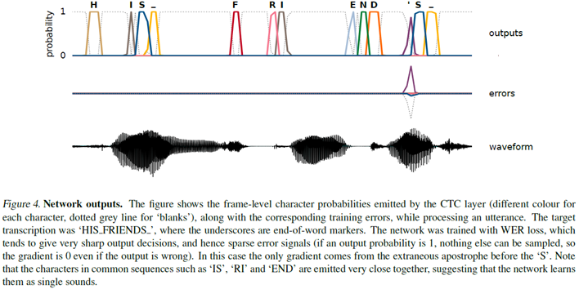
Speech recognition with RNN

Slide 50
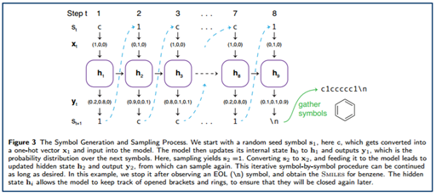
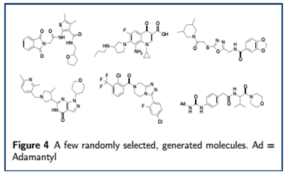
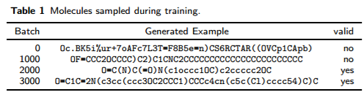
Generate Molecular structures with RNN

Slide 51
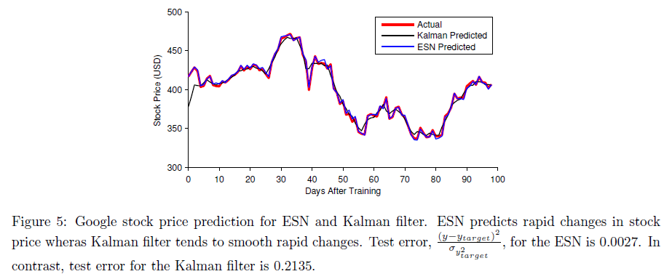
Predict Stock prices with RNN

Slide 52
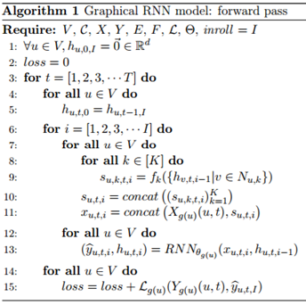
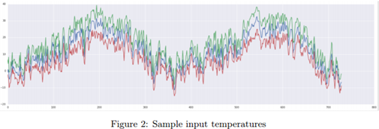

Weather prediction with Graphical RNN

Slide 53

RNN in TensorFlow
cell = tf.contrib.rnn.BasicRNNCell(num_units=hidden_size) ... outputs, _states = tf.nn.dynamic_rnn(cell, x_data, dtype=tf.float32)
https://github.com/hunkim/DeepLearningZeroToAll/blob/master/lab-12-0-rnn_basics.ipynb

Slide 54

One node: 4 (input-dim) in 2 (hidden_size)

Slide 55
One node: 4 (input-dim) in 2 (hidden_size)
# One cell RNN input_dim (4) -> output_dim (2) hidden_size = 2 cell = tf.contrib.rnn.BasicRNNCell(num_units=hidden_size) x_data = np.array([[[1,0,0,0]]], dtype=np.float32)
outputs, _states = tf.nn.dynamic_rnn(cell, x_data, dtype=tf.float32) sess.run(tf.global_variables_initializer()) pp.pprint(outputs.eval())
array([[[-0.42409304, 0.64651132]]])
https://github.com/hunkim/DeepLearningZeroToAll/blob/master/lab-12-0-rnn_basics.ipynb

Slide 56



Unfolding to n sequences
Hidden_size=2
sequence_length=5
https://github.com/hunkim/DeepLearningZeroToAll/blob/master/lab-12-0-rnn_basics.ipynb

Slide 57

Unfolding to n sequences
# One cell RNN input_dim (4) -> output_dim (2). sequence: 5 hidden_size = 2 cell = tf.contrib.rnn.BasicRNNCell(num_units=hidden_size) x_data = np.array([[h, e, l, l, o]], dtype=np.float32) print(x_data.shape) pp.pprint(x_data) outputs, states = tf.nn.dynamic_rnn(cell, x_data, dtype=tf.float32) sess.run(tf.global_variables_initializer()) pp.pprint(outputs.eval())
X_data = array
([[[ 1., 0., 0., 0.], [ 0., 1., 0., 0.], [ 0., 0., 1., 0.], [ 0., 0., 1., 0.], [ 0., 0., 0., 1.]]], dtype=float32) Outputs = array
([[[ 0.19709368, 0.24918222], [-0.11721198, 0.1784237 ], [-0.35297349, -0.66278851], [-0.70915914, -0.58334434], [-0.38886023, 0.47304463]]], dtype=float32)
Hidden_size=2
sequence_length=5
https://github.com/hunkim/DeepLearningZeroToAll/blob/master/lab-12-0-rnn_basics.ipynb

Slide 58

Batching input
Hidden_size=2
sequence_length=5
batch_size=3

Slide 59
Batching input
# One cell RNN input_dim (4) -> output_dim (2). sequence: 5, batch 3 # 3 batches 'hello', 'eolll', 'lleel' x_data = np.array([[h, e, l, l, o], [e, o, l, l, l], [l, l, e, e, l]], dtype=np.float32) pp.pprint(x_data) cell = rnn.BasicLSTMCell(num_units=2, state_is_tuple=True) outputs, _states = tf.nn.dynamic_rnn(cell, x_data,
dtype=tf.float32) sess.run(tf.global_variables_initializer()) pp.pprint(outputs.eval())
array([[[ 1., 0., 0., 0.], [ 0., 1., 0., 0.], [ 0., 0., 1., 0.], [ 0., 0., 1., 0.], [ 0., 0., 0., 1.]], [[ 0., 1., 0., 0.], [ 0., 0., 0., 1.], [ 0., 0., 1., 0.], [ 0., 0., 1., 0.], [ 0., 0., 1., 0.]], [[ 0., 0., 1., 0.], [ 0., 0., 1., 0.], [ 0., 1., 0., 0.], [ 0., 1., 0., 0.], [ 0., 0., 1., 0.]]],
Hidden_size=2
sequence_length=5
batch_size=3
https://github.com/hunkim/DeepLearningZeroToAll/blob/master/lab-12-0-rnn_basics.ipynb

Slide 60
Batching input
# One cell RNN input_dim (4) -> output_dim (2). sequence: 5, batch 3 # 3 batches 'hello', 'eolll', 'lleel' x_data = np.array([[h, e, l, l, o], [e, o, l, l, l], [l, l, e, e, l]], dtype=np.float32) pp.pprint(x_data) cell = rnn.BasicLSTMCell(num_units=2, state_is_tuple=True) outputs, _states = tf.nn.dynamic_rnn(cell, x_data,
dtype=tf.float32) sess.run(tf.global_variables_initializer()) pp.pprint(outputs.eval())
array([[[ 1., 0., 0., 0.], [ 0., 1., 0., 0.], [ 0., 0., 1., 0.], [ 0., 0., 1., 0.], [ 0., 0., 0., 1.]], [[ 0., 1., 0., 0.], [ 0., 0., 0., 1.], [ 0., 0., 1., 0.], [ 0., 0., 1., 0.], [ 0., 0., 1., 0.]], [[ 0., 0., 1., 0.], [ 0., 0., 1., 0.], [ 0., 1., 0., 0.], [ 0., 1., 0., 0.], [ 0., 0., 1., 0.]]],
array([[[-0.0173022 , -0.12929453], [-0.14995177, -0.23189341], [ 0.03294011, 0.01962204], [ 0.12852104, 0.12375218], [ 0.13597946, 0.31746736]], [[-0.15243632, -0.14177315], [ 0.04586344, 0.12249056], [ 0.14292534, 0.15872268], [ 0.18998367, 0.21004884], [ 0.21788891, 0.24151592]], [[ 0.10713603, 0.11001928], [ 0.17076059, 0.1799853 ], [-0.03531617, 0.08993293], [-0.1881337 , -0.08296411], [-0.00404597, 0.07156041]]],
Hidden_size=2
sequence_length=5
batch_size=3
https://github.com/hunkim/DeepLearningZeroToAll/blob/master/lab-12-0-rnn_basics.ipynb

Slide 61

Hi Hello RNN

Slide 62

Teach RNN ‘hihello’
i
h
e
l
l
o
h
i
h
e
l
l

Slide 63

One-hot encoding
text: ‘hihello’
unique chars (vocabulary, voc):
h, i, e, l, o
voc index:
h:0, i:1, e:2, l:3, o:4
[1, 0, 0, 0, 0], # h 0
[0, 1, 0, 0, 0], # i 1
[0, 0, 1, 0, 0], # e 2
[0, 0, 0, 1, 0], # l 3
[0, 0, 0, 0, 1], # o 4

Slide 64
Teach RNN ‘hihello’
[1, 0, 0, 0, 0], # h 0
[0, 1, 0, 0, 0], # i 1
[0, 0, 1, 0, 0], # e 2
[0, 0, 0, 1, 0], # l 3
[0, 0, 0, 0, 1], # o 4
[0, 1, 0, 0, 0]
[1, 0, 0, 0, 0]
[0, 1, 0, 0, 0]
[0, 1, 0, 0, 0]
[0, 1, 0, 0, 0]
[0, 0, 0, 0, 1]
i
h
e
l
l
o
h
i
h
e
l
l
[1, 0, 0, 0, 0]
[0, 1, 0, 0, 0]
[1, 0, 0, 0, 0]
[0, 1, 0, 0, 0]
[0, 1, 0, 0, 0]
[0, 1, 0, 0, 0]

Slide 65
Creating rnn cell
# RNN model
rnn_cell = rnn_cell.BasicRNNCell(rnn_size)
rnn_cell = rnn_cell. BasicLSTMCell(rnn_size)
rnn_cell = rnn_cell. GRUCell(rnn_size)

Slide 66
Creating rnn cell
# RNN model
rnn_cell = rnn_cell.BasicRNNCell(rnn_size)
rnn_cell = rnn_cell. BasicLSTMCell(rnn_size)
rnn_cell = rnn_cell. GRUCell(rnn_size)

Slide 67
Execute RNN
hidden_rnn_size
# RNN model
rnn_cell = rnn_cell.BasicRNNCell(rnn_size)
outputs, _states = tf.nn.dynamic_rnn(
rnn_cell,
X,
initial_state=initial_state,
dtype=tf.float32)

Slide 68
RNN parameters
text: ‘hihello’
unique chars (vocabulary, voc):
h, i, e, l, o
voc index:
h:0, i:1, e:2, l:3, o:4
hidden_size = 5 # output from the LSTM
input_dim = 5 # one-hot size
batch_size = 1 # one sentence
sequence_length = 6 # |ihello| == 6
https://github.com/hunkim/DeepLearningZeroToAll/blob/master/lab-12-1-hello-rnn.py

Slide 69
Data creation
idx2char = ['h', 'i', 'e', 'l', 'o'] # h=0, i=1, e=2, l=3, o=4
x_data = [[0, 1, 0, 2, 3, 3]] # hihell
x_one_hot = [[[1, 0, 0, 0, 0], # h 0
[0, 1, 0, 0, 0], # i 1
[1, 0, 0, 0, 0], # h 0
[0, 0, 1, 0, 0], # e 2
[0, 0, 0, 1, 0], # l 3
[0, 0, 0, 1, 0]]] # l 3
y_data = [[1, 0, 2, 3, 3, 4]] # ihello
X = tf.placeholder(tf.float32,
[None, sequence_length, input_dim]) # X one-hot
Y = tf.placeholder(tf.int32, [None, sequence_length]) # Y label
https://github.com/hunkim/DeepLearningZeroToAll/blob/master/lab-12-1-hello-rnn.py

Slide 70
Feed to RNN
x_one_hot = [[[1, 0, 0, 0, 0], # h 0
[0, 1, 0, 0, 0], # i 1
[1, 0, 0, 0, 0], # h 0
[0, 0, 1, 0, 0], # e 2
[0, 0, 0, 1, 0], # l 3
[0, 0, 0, 1, 0]]] # l 3
y_data = [[1, 0, 2, 3, 3, 4]] # ihello
X = tf.placeholder(
tf.float32, [None, sequence_length, hidden_size]) # X one-hot
Y = tf.placeholder(tf.int32, [None, sequence_length]) # Y label
cell = tf.contrib.rnn.BasicLSTMCell(num_units=hidden_size, state_is_tuple=True)
initial_state = cell.zero_state(batch_size, tf.float32)
outputs, _states = tf.nn.dynamic_rnn(
cell, X, initial_state=initial_state, dtype=tf.float32)
https://github.com/hunkim/DeepLearningZeroToAll/blob/master/lab-12-1-hello-rnn.py

Slide 71

Cost: sequence_loss
https://github.com/hunkim/DeepLearningZeroToAll/blob/master/lab-12-0-rnn_basics.ipynb

Slide 72

Cost: sequence_loss
https://github.com/hunkim/DeepLearningZeroToAll/blob/master/lab-12-0-rnn_basics.ipynb

Slide 73
Cost: sequence_loss
outputs, _states = tf.nn.dynamic_rnn(
cell, X, initial_state=initial_state, dtype=tf.float32)
weights = tf.ones([batch_size, sequence_length])
sequence_loss = tf.contrib.seq2seq.sequence_loss(
logits=outputs, targets=Y, weights=weights)
loss = tf.reduce_mean(sequence_loss)
train = tf.train.AdamOptimizer(learning_rate=0.1).minimize(loss)
https://github.com/hunkim/DeepLearningZeroToAll/blob/master/lab-12-1-hello-rnn.py

Slide 74
Training
prediction = tf.argmax(outputs, axis=2)
with tf.Session() as sess:
sess.run(tf.global_variables_initializer())
for i in range(2000):
l, _ = sess.run([loss, train], feed_dict={X: x_one_hot, Y: y_data})
result = sess.run(prediction, feed_dict={X: x_one_hot})
print(i, "loss:", l, "prediction: ", result, "true Y: ", y_data)
# print char using dic
result_str = [idx2char[c] for c in np.squeeze(result)]
print("\tPrediction str: ", ''.join(result_str))
https://github.com/hunkim/DeepLearningZeroToAll/blob/master/lab-12-1-hello-rnn.py

Slide 75
Results
prediction = tf.argmax(outputs, axis=2)
with tf.Session() as sess:
sess.run(tf.global_variables_initializer())
for i in range(2000):
l, _ = sess.run([loss, train], feed_dict={X: x_one_hot, Y: y_data})
result = sess.run(prediction, feed_dict={X: x_one_hot})
print(i, "loss:", l, "prediction: ", result, "true Y: ", y_data)
# print char using dic
result_str = [idx2char[c] for c in np.squeeze(result)]
print("\tPrediction str: ", ''.join(result_str))
0 loss: 1.55474 prediction: [[3 3 3 3 4 4]] true Y: [[1, 0, 2, 3, 3, 4]] Prediction str: lllloo
1 loss: 1.55081 prediction: [[3 3 3 3 4 4]] true Y: [[1, 0, 2, 3, 3, 4]] Prediction str: lllloo
2 loss: 1.54704 prediction: [[3 3 3 3 4 4]] true Y: [[1, 0, 2, 3, 3, 4]] Prediction str: lllloo
3 loss: 1.54342 prediction: [[3 3 3 3 4 4]] true Y: [[1, 0, 2, 3, 3, 4]] Prediction str: lllloo
...
1998 loss: 0.75305 prediction: [[1 0 2 3 3 4]] true Y: [[1, 0, 2, 3, 3, 4]] Prediction str: ihello
1999 loss: 0.752973 prediction: [[1 0 2 3 3 4]] true Y: [[1, 0, 2, 3, 3, 4]] Prediction str: ihello
https://github.com/hunkim/DeepLearningZeroToAll/blob/master/lab-12-1-hello-rnn.py

Slide 76
RNN with long sequences

Slide 77
Manual data creation
idx2char = ['h', 'i', 'e', 'l', 'o']
x_data = [[0, 1, 0, 2, 3, 3]] # hihell
x_one_hot = [[[1, 0, 0, 0, 0], # h 0
[0, 1, 0, 0, 0], # i 1
[1, 0, 0, 0, 0], # h 0
[0, 0, 1, 0, 0], # e 2
[0, 0, 0, 1, 0], # l 3
[0, 0, 0, 1, 0]]] # l 3
y_data = [[1, 0, 2, 3, 3, 4]] # ihello
https://github.com/hunkim/DeepLearningZeroToAll/blob/master/lab-12-1-hello-rnn.py

Slide 78
Better data creation
sample = " if you want you"
idx2char = list(set(sample)) # index -> char
char2idx = {c: i for i, c in enumerate(idx2char)} # char -> idx
sample_idx = [char2idx[c] for c in sample] # char to index
x_data = [sample_idx[:-1]] # X data sample (0 ~ n-1) hello: hell
y_data = [sample_idx[1:]] # Y label sample (1 ~ n) hello: ello
X = tf.placeholder(tf.int32, [None, sequence_length]) # X data
Y = tf.placeholder(tf.int32, [None, sequence_length]) # Y label
X_one_hot = tf.one_hot(X, num_classes) # one hot: 1 -> 0 1 0 0 0 0 0 0 0 0
https://github.com/hunkim/DeepLearningZeroToAll/blob/master/lab-12-2-char-seq-rnn.py

Slide 79
Hyper parameters
sample = " if you want you"
idx2char = list(set(sample)) # index -> char
char2idx = {c: i for i, c in enumerate(idx2char)} # char -> idx
# hyper parameters
dic_size = len(char2idx) # RNN input size (one hot size)
rnn_hidden_size = len(char2idx) # RNN output size
num_classes = len(char2idx) # final output size (RNN or softmax, etc.)
batch_size = 1 # one sample data, one batch
sequence_length = len(sample) - 1 # number of lstm unfolding (unit #)

Slide 80
LSTM and Loss
X = tf.placeholder(tf.int32, [None, sequence_length]) # X data
Y = tf.placeholder(tf.int32, [None, sequence_length]) # Y label
X_one_hot = tf.one_hot(X, num_classes) # one hot: 1 -> 0 1 0 0 0 0 0 0 0 0
cell = tf.contrib.rnn.BasicLSTMCell(num_units=rnn_hidden_size, state_is_tuple=True)
initial_state = cell.zero_state(batch_size, tf.float32)
outputs, _states = tf.nn.dynamic_rnn(
cell, X_one_hot, initial_state=initial_state, dtype=tf.float32)
weights = tf.ones([batch_size, sequence_length])
sequence_loss = tf.contrib.seq2seq.sequence_loss(logits=outputs, targets=Y,weights=weights)
loss = tf.reduce_mean(sequence_loss)
train = tf.train.GradientDescentOptimizer(learning_rate=0.1).minimize(loss)
prediction = tf.argmax(outputs, axis=2)
https://github.com/hunkim/DeepLearningZeroToAll/blob/master/lab-12-2-char-seq-rnn.py

Slide 81
Training and Results
with tf.Session() as sess:
sess.run(tf.global_variables_initializer())
for i in range(3000):
l, _ = sess.run([loss, train], feed_dict={X: x_data, Y: y_data})
result = sess.run(prediction, feed_dict={X: x_data})
# print char using dic
result_str = [idx2char[c] for c in np.squeeze(result)]
print(i, "loss:", l, "Prediction:", ''.join(result_str))
0 loss: 2.29895 Prediction: nnuffuunnuuuyuy
1 loss: 2.29675 Prediction: nnuffuunnuuuyuy
...
1418 loss: 1.37351 Prediction: if you want you
1419 loss: 1.37331 Prediction: if you want you
https://github.com/hunkim/DeepLearningZeroToAll/blob/master/lab-12-2-char-seq-rnn.py

Slide 82
Really long sentence?
sentence = ("if you want to build a ship, don't drum up people together to "
"collect wood and don't assign them tasks and work, but rather "
"teach them to long for the endless immensity of the sea.")
https://github.com/hunkim/DeepLearningZeroToAll/blob/master/lab-12-4-rnn_long_char.py

Slide 83
Really long sentence?
sentence = ("if you want to build a ship, don't drum up people together to "
"collect wood and don't assign them tasks and work, but rather "
"teach them to long for the endless immensity of the sea.")
# training dataset
0 if you wan -> f you want
1 f you want -> you want
2 you want -> you want t
3 you want t -> ou want to
…
168 of the se -> of the sea
169 of the sea -> f the sea.
https://github.com/hunkim/DeepLearningZeroToAll/blob/master/lab-12-4-rnn_long_char.py

Slide 84
Making dataset
char_set = list(set(sentence))
char_dic = {w: i for i, w in enumerate(char_set)}
dataX = []
dataY = []
for i in range(0, len(sentence) - seq_length):
x_str = sentence[i:i + seq_length]
y_str = sentence[i + 1: i + seq_length + 1]
print(i, x_str, '->', y_str)
x = [char_dic[c] for c in x_str] # x str to index
y = [char_dic[c] for c in y_str] # y str to index
dataX.append(x)
dataY.append(y)
# training dataset
0 if you wan -> f you want
1 f you want -> you want
2 you want -> you want t
3 you want t -> ou want to
…
168 of the se -> of the sea
169 of the sea -> f the sea.
https://github.com/hunkim/DeepLearningZeroToAll/blob/master/lab-12-4-rnn_long_char.py

Slide 85
RNN parameters
char_set = list(set(sentence))
char_dic = {w: i for i, w in enumerate(char_set)}
data_dim = len(char_set)
hidden_size = len(char_set)
num_classes = len(char_set)
seq_length = 10 # Any arbitrary number
batch_size = len(dataX)
# training dataset
0 if you wan -> f you want
1 f you want -> you want
2 you want -> you want t
3 you want t -> ou want to
…
168 of the se -> of the sea
169 of the sea -> f the sea.
https://github.com/hunkim/DeepLearningZeroToAll/blob/master/lab-12-4-rnn_long_char.py

Slide 86

Stacked RNN
X = tf.placeholder(tf.int32, [None, seq_length])
Y = tf.placeholder(tf.int32, [None, seq_length])
# One-hot encoding
X_one_hot = tf.one_hot(X, num_classes)
print(X_one_hot) # check out the shape
# Make a lstm cell with hidden_size (each unit output vector size)
cell = rnn.BasicLSTMCell(hidden_size, state_is_tuple=True)
cell = rnn.MultiRNNCell([cell] * 2, state_is_tuple=True)
# outputs: unfolding size x hidden size, state = hidden size
outputs, _states = tf.nn.dynamic_rnn(cell, X_one_hot, dtype=tf.float32)
https://github.com/hunkim/DeepLearningZeroToAll/blob/master/lab-12-4-rnn_long_char.py

Slide 87

Softmax (FC) in Deep CNN
Image credit: http://personal.ie.cuhk.edu.hk/~ccloy/project_target_code/index.html

Slide 88

Softmax
outputs, _ = tf.nn.dynamic_rnn(cell, X_one_hot)
https://github.com/hunkim/DeepLearningZeroToAll/blob/master/lab-12-4-rnn_long_char.py

Slide 89
Softmax
outputs = tf.reshape(outputs,
[batch_size, seq_length, num_classes])
X_for_softmax = tf.reshape(outputs,
[-1, hidden_size])
outputs, _ = tf.nn.dynamic_rnn(cell, X_one_hot)
https://github.com/hunkim/DeepLearningZeroToAll/blob/master/lab-12-4-rnn_long_char.py

Slide 90
Softmax
# (optional) softmax layer
X_for_softmax = tf.reshape(outputs, [-1, hidden_size])
softmax_w = tf.get_variable("softmax_w",
[hidden_size, num_classes]
softmax_b = tf.get_variable("softmax_b",[num_classes])
outputs = tf.matmul(X_for_softmax,softmax_w) + softmax_b
outputs = tf.reshape(outputs,
[batch_size, seq_length, num_classes])
https://github.com/hunkim/DeepLearningZeroToAll/blob/master/lab-12-4-rnn_long_char.py

Slide 91
Loss
# reshape out for sequence_loss
outputs = tf.reshape(outputs,
[batch_size, seq_length, num_classes])
# All weights are 1 (equal weights)
weights = tf.ones([batch_size, seq_length])
sequence_loss = tf.contrib.seq2seq.sequence_loss(
logits=outputs, targets=Y, weights=weights)
mean_loss = tf.reduce_mean(sequence_loss)
train_op =
tf.train.AdamOptimizer(learning_rate=0.1).minimize(mean_loss)
https://github.com/hunkim/DeepLearningZeroToAll/blob/master/lab-12-4-rnn_long_char.py

Slide 92
Training and print results
0 167 tttttttttt 3.23111
0 168 tttttttttt 3.23111
0 169 tttttttttt 3.23111
…
499 167 oof the se 0.229306
499 168 tf the sea 0.229306
499 169 n the sea. 0.229306
sess = tf.Session()
sess.run(tf.global_variables_initializer()
for i in range(500):
_, l, results = sess.run(
[train_op, mean_loss, outputs],
feed_dict={X: dataX, Y: dataY})
for j, result in enumerate(results):
index = np.argmax(result, axis=1)
print(i, j, ''.join([char_set[t] for t in index]), l)
https://github.com/hunkim/DeepLearningZeroToAll/blob/master/lab-12-4-rnn_long_char.py

Slide 93
Training and print results
# Let's print the last char of each result to check it works
results = sess.run(outputs, feed_dict={X: dataX})
for j, result in enumerate(results):
index = np.argmax(result, axis=1)
if j is 0: # print all for the first result to make a sentence
print(''.join([char_set[t] for t in index]), end='')
else:
print(char_set[index[-1]], end='')
g you want to build a ship, don't drum up people together to collect wood and don't assign them tasks and work, but rather teach them to long for the endless immensity of the sea.
https://github.com/hunkim/DeepLearningZeroToAll/blob/master/lab-12-4-rnn_long_char.py

Slide 94
char-rnn

Slide 96
char/word rnn (char/word level n to n model)
https://github.com/sherjilozair/char-rnn-tensorflow
https://github.com/hunkim/word-rnn-tensorflow

Slide 97

RNN with time series data (stock)

Slide 98
Time series data

Slide 99
Time series data
Open | High | Low | Volume | Close
828.659973 | 833.450012 | 828.349976 | 1247700 | 831.659973
823.02002 | 828.070007 | 821.655029 | 1597800 | 828.070007
819.929993 | 824.400024 | 818.97998 | 1281700 | 824.159973
819.359985 | 823 | 818.469971 | 1304000 | 818.97998
819 | 823 | 816 | 1053600 | 820.450012
816 | 820.958984 | 815.48999 | 1198100 | 819.23999
811.700012 | 815.25 | 809.780029 | 1129100 | 813.669983
809.51001 | 810.659973 | 804.539978 | 989700 | 809.559998
807 | 811.840027 | 803.190002 | 1155300 | 808.380005
'data-02-stock_daily.csv'

Slide 100

Many to one
8
1
2
3
4
5
6
7
https://github.com/hunkim/DeepLearningZeroToAll/blob/master/lab-12-5-rnn_stock_prediction.py

Slide 101
Reading data
timesteps = seq_length = 7
data_dim = 5
output_dim = 1
# Open,High,Low,Close,Volume
xy = np.loadtxt('data-02-stock_daily.csv', delimiter=',')
xy = xy[::-1] # reverse order (chronically ordered)
xy = MinMaxScaler(xy)
x = xy
y = xy[:, [-1]] # Close as label
dataX = []
dataY = []
for i in range(0, len(y) - seq_length):
_x = x[i:i + seq_length]
_y = y[i + seq_length] # Next close price
print(_x, "->", _y)
dataX.append(_x)
dataY.append(_y)
[[ 0.18667876 0.20948057 0.20878184 0. 0.21744815]
[ 0.30697388 0.31463414 0.21899367 0.01247647 0.21698189]
[ 0.21914211 0.26390721 0.2246864 0.45632338 0.22496747]
[ 0.23312993 0.23641916 0.16268272 0.57017119 0.14744274]
[ 0.13431201 0.15175877 0.11617252 0.39380658 0.13289962]
[ 0.13973232 0.17060429 0.15860382 0.28173344 0.18171679]
[ 0.18933069 0.20057799 0.19187983 0.29783096 0.2086465 ]]
--> [ 0.14106001]
https://github.com/hunkim/DeepLearningZeroToAll/blob/master/lab-12-5-rnn_stock_prediction.py

Slide 102
Training and test datasets
# split to train and testing
train_size = int(len(dataY) * 0.7)
test_size = len(dataY) - train_size
trainX, testX = np.array(dataX[0:train_size]),
np.array(dataX[train_size:len(dataX)])
trainY, testY = np.array(dataY[0:train_size]),
np.array(dataY[train_size:len(dataY)])
# input placeholders
X = tf.placeholder(tf.float32, [None, seq_length, data_dim])
Y = tf.placeholder(tf.float32, [None, 1])
https://github.com/hunkim/DeepLearningZeroToAll/blob/master/lab-12-5-rnn_stock_prediction.py

Slide 103
LSTM and Loss
# input placeholders
X = tf.placeholder(tf.float32, [None, seq_length, data_dim])
Y = tf.placeholder(tf.float32, [None, 1])
cell = tf.contrib.rnn.BasicLSTMCell(num_units=output_dim, state_is_tuple=True)
outputs, _states = tf.nn.dynamic_rnn(cell, X, dtype=tf.float32)
Y_pred = outputs[:, -1] # We use the last cell's output
# cost/loss
loss = tf.reduce_sum(tf.square(Y_pred - Y)) # sum of the squares
# optimizer
optimizer = tf.train.GradientDescentOptimizer(0.01)
train = optimizer.minimize(loss)
https://github.com/hunkim/DeepLearningZeroToAll/blob/master/lab-12-5-rnn_stock_prediction.py

Slide 104

Training and Results
sess = tf.Session()
sess.run(tf.global_variables_initializer())
for i in range(1000):
_, l = sess.run([train, loss],
feed_dict={X: trainX, Y: trainY})
print(i, l)
testPredict = sess.run(Y_pred, feed_dict={X: testX})
import matplotlib.pyplot as plt
plt.plot(testY)
plt.plot(testPredict)
plt.show()
https://github.com/hunkim/DeepLearningZeroToAll/blob/master/lab-12-5-rnn_stock_prediction.py

Slide 105
Exercise
Implement stock prediction using linear regression only
Improve stock prediction results using more features such as keywords and/or sentiments in top news
Implement sequence to sequence mode (translate a language to another)
https://github.com/hunkim/DeepLearningZeroToAll/blob/master/Keras/klab-12-5-seq2seq.py

Slide 106
Deep Learning
DNN
CNN
RNN

Slide 107

Other RNN applications
Language Modeling
Speech Recognition
Machine Translation
Conversation Modeling/Question Answering
Image/Video Captioning
Image/Music/Dance Generation
http://jiwonkim.org/awesome-rnn/

Slide 108

http://www.asimovinstitute.org/neural-network-zoo/

Slide 109

http://www.asimovinstitute.org/neural-network-zoo/

Slide 110




Rule based programming VS data driven learning

Slide 111

Deep Coding Project @UST
Software creates software?
Interested in? hunkim+deepcoding@gmail.com

Slide 112
Backup Slides

Slide 114
Dynamic RNN
With TF 1.0!

Slide 115
Different sequence length
h e l l o
h i
w h y
...

Slide 116
Different sequence length
h e l l o
h i <pad> <pad> <pad>
w h y <pad> <pad>
...

Slide 117
Different sequence length
sequence_length=[5,2,3]
h e l l o
h i
w h y
...

Slide 118
Dynamic RNN
array([[[-0.17904168, -0.08053244], [-0.01294809, 0.01660814], [-0.05754048, -0.1368292 ], [-0.08655578, -0.20553185], [ 0.07297077, -0.21743253]], [[ 0.10272847, 0.06519825], [ 0.20188759, -0.05027055], [ 0.09514933, -0.16452041], [ 0. , 0. ], [ 0. , 0. ]], [[-0.04893036, -0.14655617], [-0.07947272, -0.20996611], [ 0.06466491, -0.02576563], [ 0.15087658, 0.05166111], [ 0. , 0. ]]],
# 3 batches 'hello', 'eolll', 'lleel' x_data = np.array([[[...]]], dtype=np.float32) hidden_size = 2 cell = rnn.BasicLSTMCell(num_units=hidden_size,
state_is_tuple=True) outputs, _states = tf.nn.dynamic_rnn( cell, x_data, sequence_length=[5,3,4],
dtype=tf.float32) sess.run(tf.global_variables_initializer()) print(outputs.eval())
https://github.com/hunkim/DeepLearningZeroToAll/blob/master/lab-12-0-rnn_basics.ipynb

